Slide 1
Programming
Guidelines
Prof. Dr. Dirk Riehle
Friedrich-Alexander University Erlangen-Nürnberg
ADAP B01
Licensed under CC BY 4.0 International
Notes:
It is Friedrich-Alexander University Erlangen-Nürnberg – FAU, in short.
Corporate identity wants us to say “Friedrich-Alexander University”.

Slide 2
Programming Guidelines
Programming guidelines …
  are are a set of rules and conventions that determine
    naming,
    formating and
    structuring
  of source code and related artifacts
Programming guidelines …
  make developers more effective
  ease reading source code
  should be mandatory

Slide 3
First Rule of Programming Guidelines
Respect existing rules and conventions

Slide 4
Java Programming Guidelines [S97]
We use the original Java guidelines: http://goo.gl/hNaJsG
  While old, these are still the current guidelines
Where those fail, we use Google’s Java guidelines
  See https://google.github.io/styleguide/javaguide.html

Slide 5
File Names
Stick to established file naming conventions
  For example, file names should match main class name
Stick to established suffixes (.java, .gradle, .war)
Stick with established file names (README, LICENSE)

Slide 6
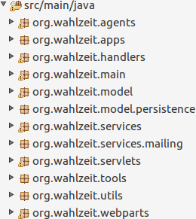
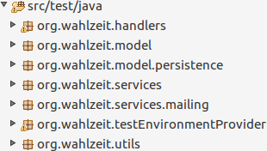
File Organization
Stick with folder structure provided as default (web apps)
Separate source from test folder hierarchy

Slide 7
File Content
Beginning comments
  Without the programmer name
Package declaration
Import statements
Program code with comments
  Class declaration
  Field declarations
  Method definition
  ...

Slide 8
File Content Example
3.1.1 Beginning Comments
All source files should begin with a c-style comment that lists the class name, version information, date, and copyright notice:
/*
* Classname
*
* Version information
*
* Date
*
* Copyright notice
*/
...

Slide 9
Naming Elements
Nouns
  Classes
  Interfaces
  Packages
  Fields
Verbs
  Methods

Slide 10
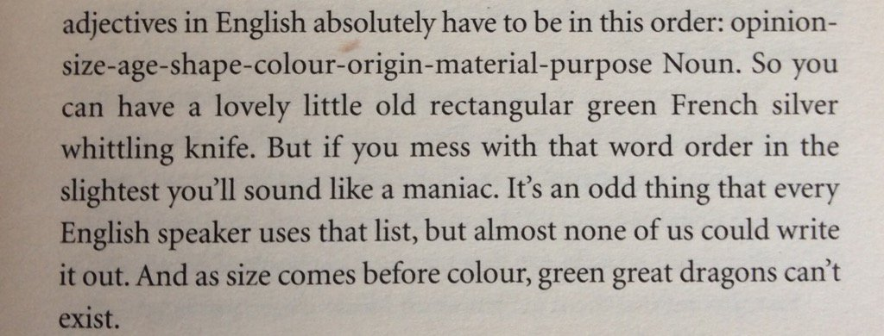
Order of Adjectives in the English Language

Slide 11
Naming Objects and Classes 1 / 2
Class and interface names
  File // no adjective
  TempFile // adding age
  BigTempFile // adding size
  BigTempHotRedFile // adding “color”
  BigTempHotRedBinaryFile // adding “material”
  BigTempSequentialHotRedBinaryFile // adding shape
Object names (variable/field names)
  invalidBigTempSequentialHotRedBinaryFile // adding opinion
  doublyInvalidBigTempSequentialHotRedBinaryFile // adding quantity
quantity - opinion - size - age - shape - color - origin - material - purpose

Slide 12
Naming Objects and Classes 2 / 2
An adjective can take the genitive form (but should rarely)
  Usually only happens if the genitive form is an established domain term
    Examples: FileOfBits vs BinaryFile, QuoteBook vs. BookOfQuotes
Use of reserved adjectives (abstract, default, etc)
  By default lead the noun (no other explanation but convention)
    Examples: AbstractSequentialFile, DefaultHashMap
Fields have an implied specifier (a, one, many, the, all)
  It is often omitted for reasons of brevity
More conventions in lectures on class and interface design

Slide 13
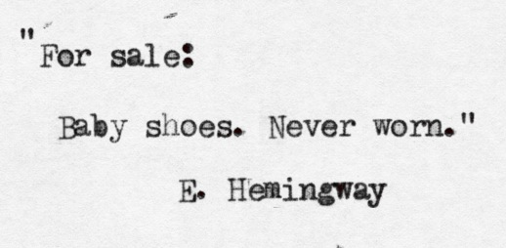
For Sale: Baby shoes. Never worn.

Slide 14
Naming Methods
Methods are commands
  Simplify, use active voice (e.g. prepare rather than bePreparedFor)
Follow established patterns
  Specifically, container(-like) classes have a fair number of conventions
    Add and remove
    Insert, prepend, append, remove
    What is the difference between remove and delete?
More conventions in lectures on method types and properties

Slide 15
Code Formatting
One statement per line
Semantic line wrapping after defined length
Use of consistent bracketing
  Sun’s guidelines don’t tell you how
  How to decide what to use?
Indentation for readability
  Use tabs not spaces

Slide 16
Techniques for Avoiding Bugs
Initialize fields where declared
Declare variables only at beginning of blocks
Bracket even single-statement blocks
…
Consider using FindBugs or similar tools

Slide 17
Techniques that Depend on Context
if (arg == null) {
return -1;
}
if (someCondition) {
return 1;
}
if (anotherCondition) {
return 2;
}
return 0;
int result = 0;
if (arg == null) {
result = -1;
} else if (someCondition) {
result = 1;
} else if (anotherCondition) {
result = 2;
} else {
result = 0;
}
}
}
return result;

Slide 18
Techniques Too Smart for the Rest of Us
if (null == arg) {
doSomething();
}

Slide 19
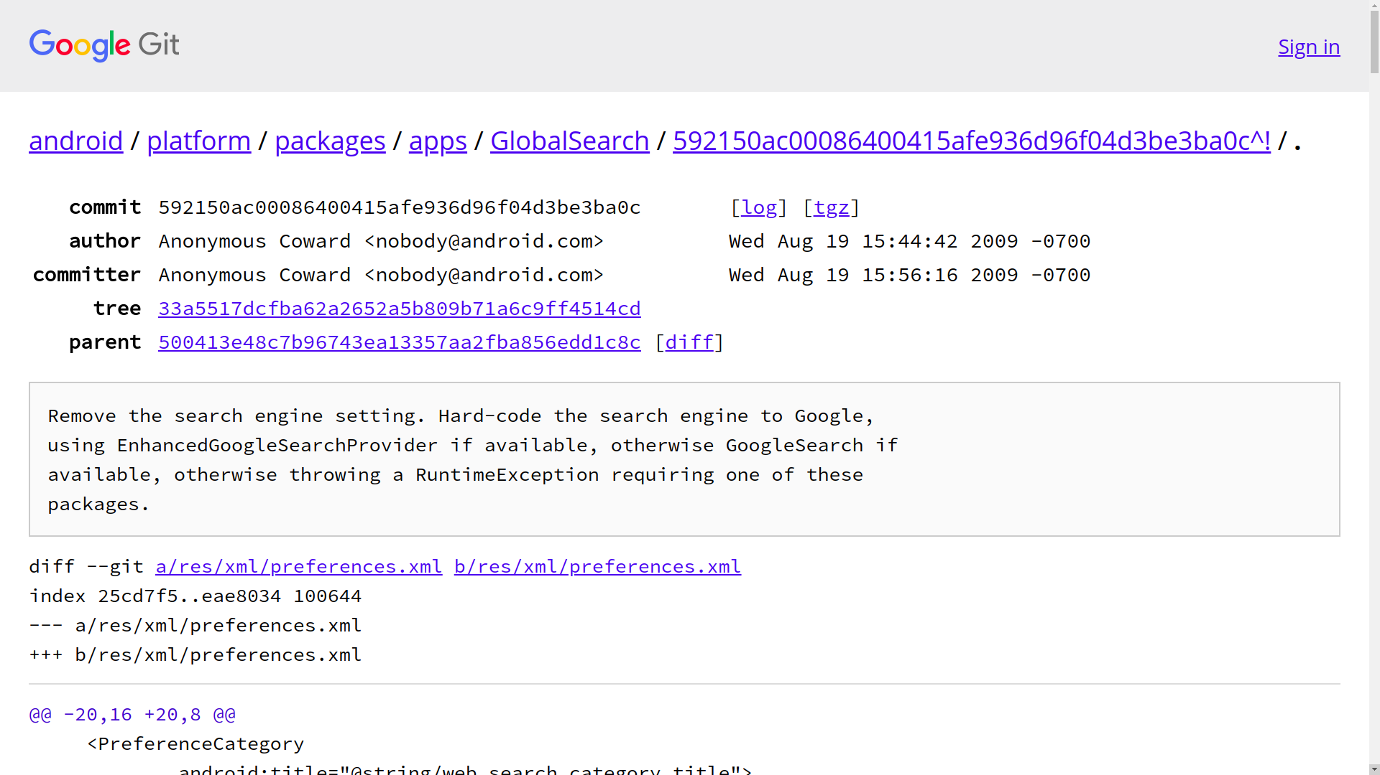
Clear Commit Messages

Slide 20
Review / Summary of Session
General programming guidelines
  What are programming guidelines?
  Why do we have them? What is their importance?
Java programming guidelines
  What are example guidelines?
  How and where to read up for a complete set?
Things not covered by guidelines
  What naming conventions beyond guidelines are there?
  What techniques? How and when to learn?

Slide 21
Thank you! Questions?
dirk.riehle@fau.de – http://osr.cs.fau.de
dirk@riehle.org – http://dirkriehle.com – @dirkriehle
DR

Slide 22
Credits and License
Original version
  © 2012-2020 Dirk Riehle, some rights reserved
  Licensed under Creative Commons Attribution 4.0 International License
Contributions
  ...

